Slide 1

Mid-Term Project
“Golden Years”
Jessica Banoke
Angela Darel
Keith Feeney
Charlene Moore

Slide 2
GOLDEN YEARS
Help seniors connect
Teaching the uses of skype, email etc.
Opening the internet world
Bringing back the joy of life
Giving the news about bingo, old style dancing parties and many more
Organising field trips
Managing health
Explaining tests results
Booking medical transport
Image on first page: (Banoke, Darel, Feeney, Moore, 2017)

Slide 3
Innovation:
Golden Years was created to
help senior citizens enjoy life
provide education on technology use
help understand medical issues and test results
Application that allows to
search for nearest events
book and pay for events
search and book medical support
provides e-learning experience for seniors

Slide 4






Technologies used:
PHP
MySQL
Visual Studio
C#
Notepad++
Git Hub / Git Bash
Image in public domain
(Tcrow777, 2008)
(Git, n.d.)
(Motaz, 2010)
(Used with permission from Microsoft)
(Used with permission from Microsoft)

Slide 5
Login System:
Sign Up:
Enter personal details.
Create username and password.
Option to save credit card details.
Sign In.
Accept information.
Store in Database.
Receives discounts after signing up.
Continue as Guests:
Book any events without creating an account.
Does not receive discounts.
Must input all details each time booking.
Personal Information does not save to database except booking confirmation to secure booking.

Slide 6
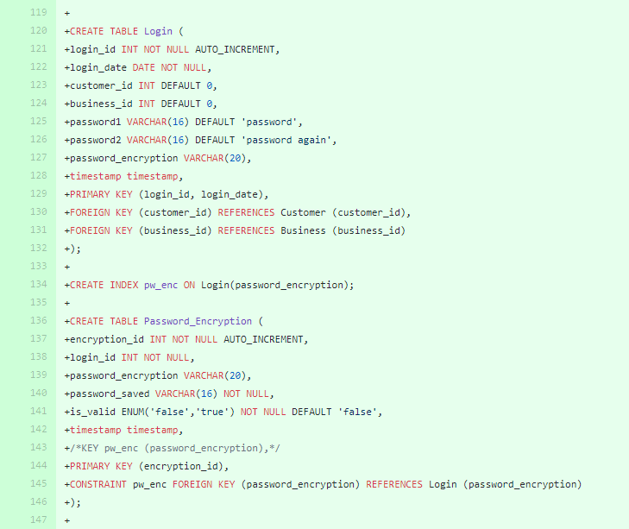
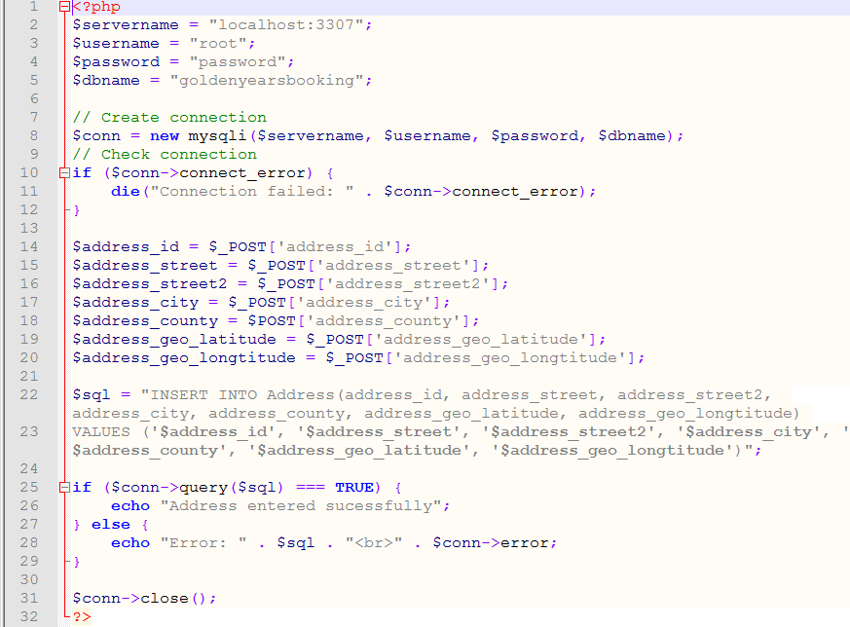
Plan to connect to the database:
Login_id
//This is the information that will be stored if you are a user.
business_id
Login_date
Customer_id
(Banoke, Darel, Feeney, Moore, 2017)
Password_encryption
(GitHub, Banoke, Darel, Feeney, Moore, 2017)

Slide 7
Payment Gateway System:
Protect credit cards details encrypting sensitive information
It ensure that information pass securely.

Slide 8
Security
Customers will be asked to enter their details when making payment.
The entire communication of the ‘submit page’ will be carried out by http protocol
The payment network provides process and service
Process
Authorisation
Settlement

Slide 9
Service:
Payment processing service:
Connecting the customers,
representative and the bank, through a secure online transaction
Getaway: The secure line between the banks and the processor.

Slide 10
Current Issues:
Connecting the Database to Web Application.
Learning PHP.
Overall aesthetics.
Group dynamics.
Visual Studios is new to three members of the group so we are still trying to get to grasps with it.
Security issues.
Cookies.

Slide 11
Progression:
Connect the database to application
Look and feel of the Web Application
Ensure our application is secure and accessible.
Adding calendar to Web Application
Future Goals:
Secure, Accessible and convenient Application.
To expand worldwide, not just Ireland based.
Allow customers to book through booking systems set up around the country. e.g. the Luas tickets system.

Slide 12
References
Tcrow777, 2008, image, viewed November 2017, <http:/en.Wikipedia.org/wiki/mysql#/media/File:mysql.svg>.
Git, n.d., image, viewed November 2017, <https://git-for-windows.github.io/img/gwindows_logo.png>.
Motaz, 2010, image, viewed November 2017, <https://upload.wikimedia.org/wikipedia/commons/f/f5/Notepad_plus_plus.png>.
Github, Bankole, J, Darel, A, Feeney, K, Moore, C, 2017, image, viewed November 2017, <https://github.com/keithfeeneynci/goldenyears>.
Bankole, J, Darel, A, Feeney, K, Moore, C, 2017, image, viewed November 2017, <https://github.com/keithfeeneynci/goldenyears>.

Slide 13
Thank you!

